Slide 1

Credit Card Fraud Detection
Pingting Gao
Yifan Gao
Joe Hu
Alexa Kung
Congci Hao

Slide 2
Business Problem - Broom Solutions
The client’s business problem is to build a data-driven fraud detection model, which will provide a significant improvement of identifying fraudulent transactions
The Correct Recall Percentage
False Positives
Revenue
The Benefit of Merchants
The consulting team’s approach addressing Broom Solutions’ credit card fraud detection is to design and build a practical and forecasting model that will result in a data-driven approach in order to deliver a recommendation regarding fraudulent detection methodology so that Broom Solutions can make data-driven strategic decisions.
Practical, but Straight-Forward Model
Tolerance on the Particular Group
Notes:
Maximize the correct recall percentage at a reasonable range
Avoid causing significant amount of false positives
Maximize the income by processing transactions as many as we can legally
Protect the merchants from losing their customer due to unsuccessful transactions
Practical, but straight-forward model to be adopted
Incorporate a reasonable tolerance on the particular group, which none of these transactions within this group will get blocked by the model

Slide 3
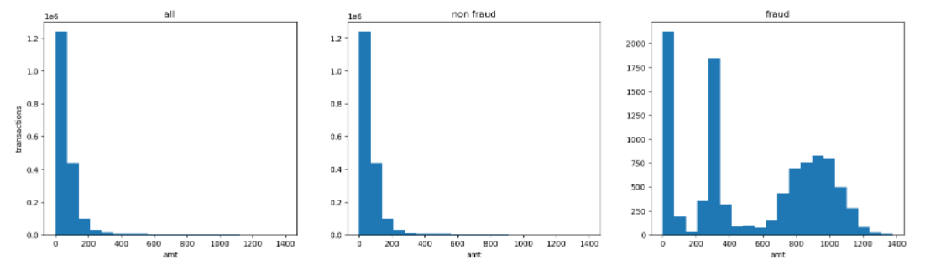
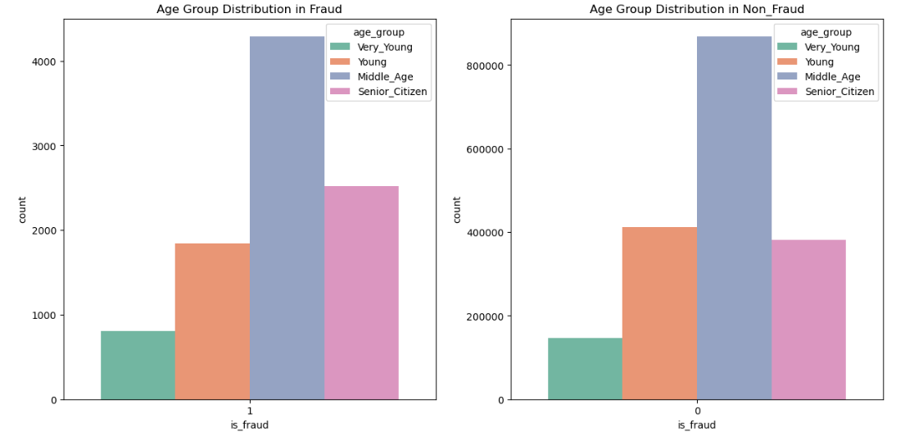
EDA
1. Non-fraudulent transactions and overall transaction are skewed to the right
2. Fraudulent transactions happen relatively more often with large amounts.
3. Middle Age(35-60) the group seems to have more fraudulent transactions than any other age group
4. Very young(19-25) age group facing paying difficulties less than any other groups

Slide 4
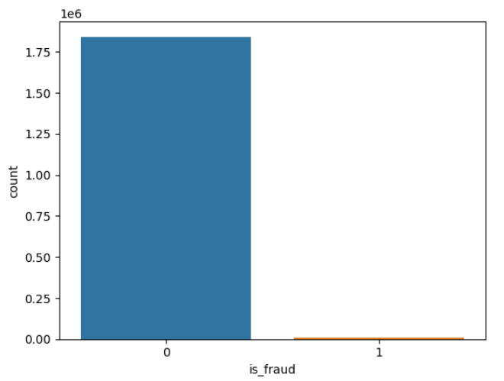

Data Imbalance and Treatment
The data set is imbalance as there is only 0.5% fraudulent transactions of overall transactions
Treatment:
Random oversampling (Current Approach)
Synthetic minority oversampling technique (SMOTE)
Autoencoder

Slide 5
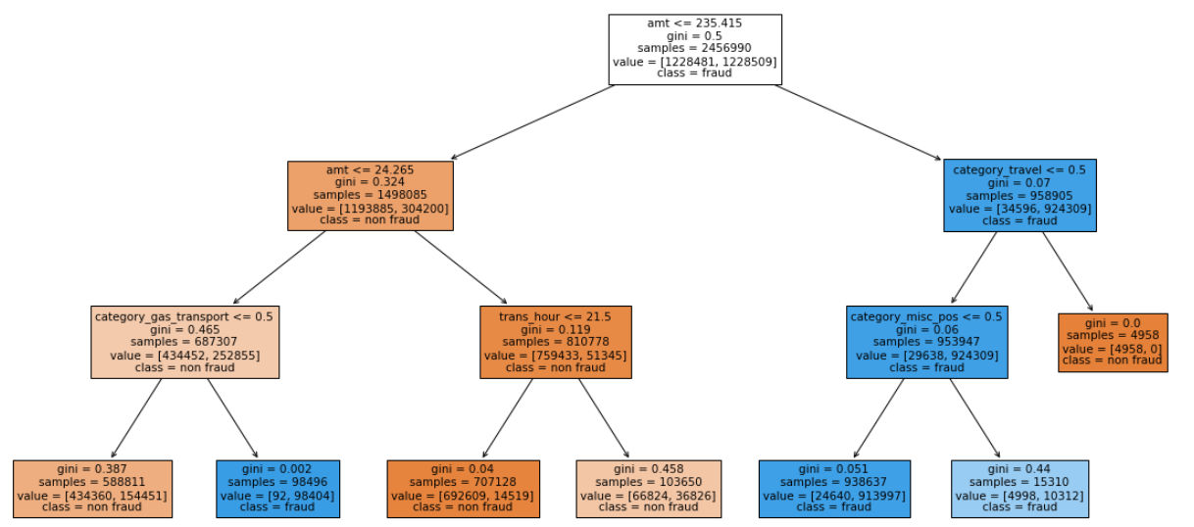
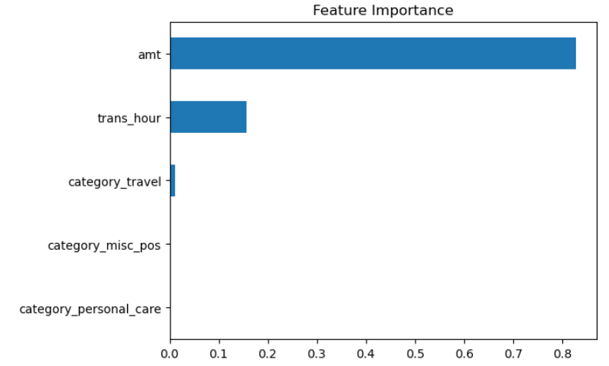
Approach - Classification
Predict fraudulent transactions is a classification problem because the response variable only contains Yes or No.
We picked the Decision Tree as the modeling approach because it is an effective method of Decision Making.
Quantifiable values of outcomes
Clear map of the decision process
Easy to evaluate possible consequences of a decision
Notes:
https://www.mindtools.com/dectree.html#:~:text=Decision%20trees%20provide%20an%20effective,the%20probabilities%20of%20achieving%20them.

Slide 6
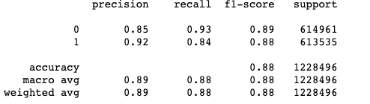
Performance Metrics - Overview
We chose precision score as our primary metric because:
Client’s concern on customers whose transactions are denied →
Need to control false positive in the model →
Favor a high precision score →
Pick decision tree model because of high interpretability and a great precision score
Category ‘1’ Model Performance
-Precision = tp/ (tp+fp) = 0.92
-Recall = tp/(tp+fn)=0.84
-F1-score = 2*((precision*recall)/(precision+recall))=0.88
Notes:
false positive in our model: those predicted with fraud transactions but in fact they are not. Therefore, we favor a high precision score, which is defined as # of True Positives/(# of True Positives + #f False Positives).
For all the models we run, we choose Decision Tree because of its good balance between interpretability and high precision score.
Typically, to tell whether a model is overfitting or underfitting, we need to review the performance metrics for both train and test datasets. Since the confusion matrices do not indicate what dataset they are based on, we cannot say whether our model is overfitting or not.

Slide 7
Performance Metrics - Overfitting
Typically, to tell whether a model is overfitting or underfitting, we need to review the performance metrics for both train and test datasets. Since the confusion matrices do not indicate which dataset they are based on, we cannot say whether our model is overfitting or not.

Slide 8
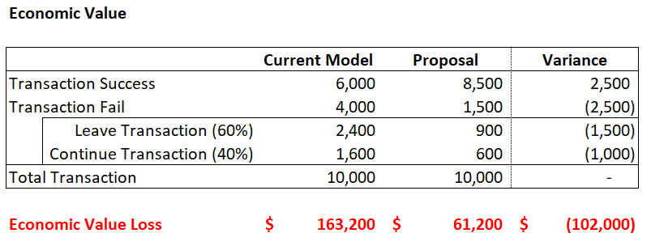
Economic Impact
The team decided to use decision tree as final model model as the result is able to be visualized into tree map, helping users to understand the decision making process.
Overall, the decision tree model helps to detect 84% of fraud transactions and shrinks down falsely detected cases to 8% of fraud detected transactions.
Assuming out of 10,000 innocent customers, we have 4,000 clients who got falsely detected, although 40% of them will try to finish the transaction, we are still losing around 2,400 clients (~$163K loss). With the model, we can improve the precision score for non-fraud transactions from .60 to .85. Which means:
The new model lowers the falsely detected client amount to from 4,000 to 1,500 people.
Compared to previous result, the new model retain 1,500 more customers (~$102K economic value)
Notes:
Feature importance: amt, cateogry_gas_transport, trans_hour, category_travel, category_misc_pos
Assumption:
After transaction denied, only 30% customer will contact credit card company , 10% will pay in cash, and 60% Customer leave the transaction.
Previous model falsely detect 60% innocent customer.
Average Fraud: $528/ non-fraud: $68

